Slide 1
Unit starter:
Grade 3
Lesson One
This Photo by Unknown Author is licensed under CC BY-SA-NC

Slide 3
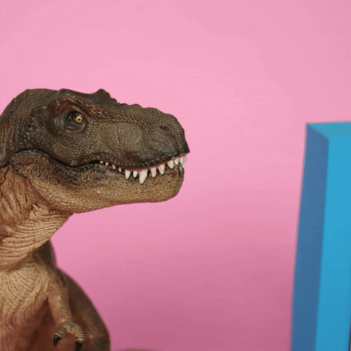
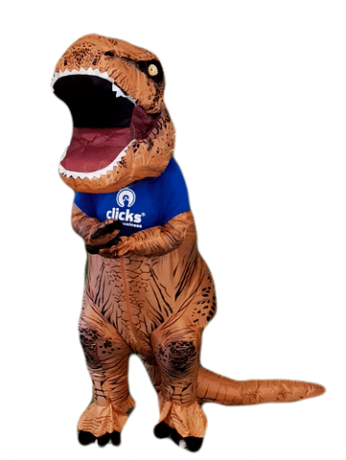
It’s time for a game!

Slide 4
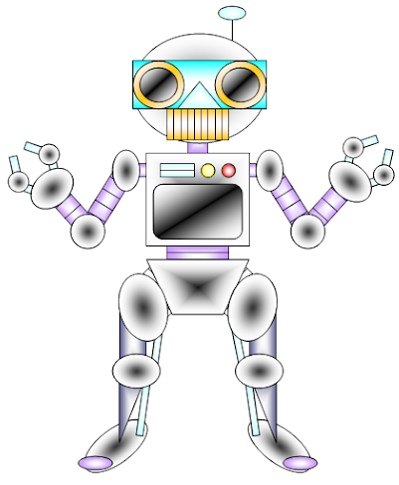
Let’s make
a robot!

Slide 5
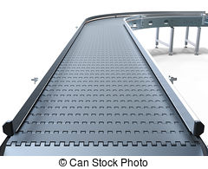
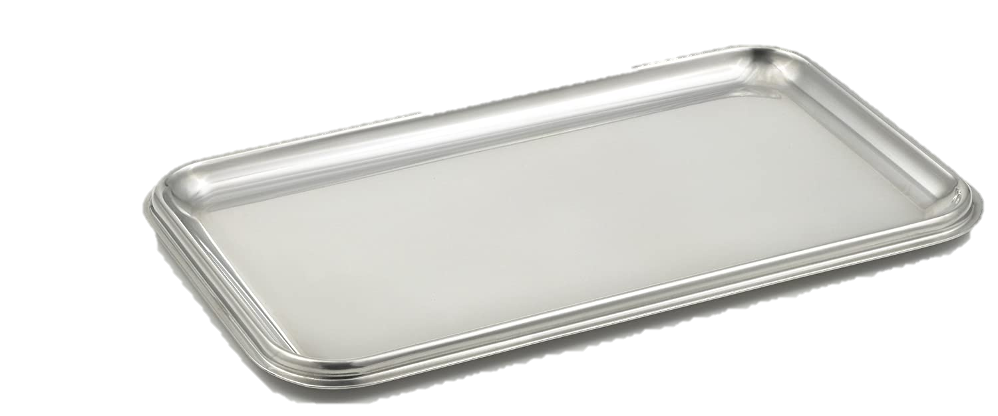
We need two legs,

Slide 6
as well as two arms,

Slide 7
and also two hands,

Slide 8
Don’t forget a face.

Slide 9
And finally, eyes!

Slide 10
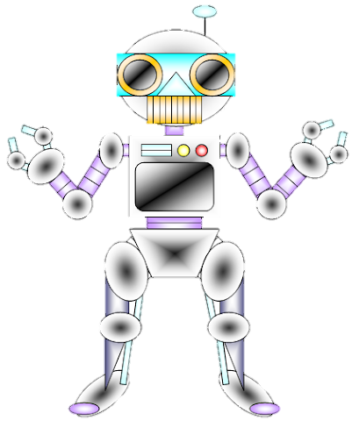

Slide 11
Listen and point

Slide 13
Listen and sing

Slide 15
Tasks: Watch a video and answer these questions
1. Where are they? 2. How many people are there?

Slide 16
Story

Slide 17
Tasks: Work in pair and answer these questions
1. Where are they? 2. How many people are there?

Slide 18
Read again

Slide 19
Tasks: Work in groups
Roleplay

Slide 20
Tasks: Worktime!
Finish the works in your workbook!

Slide 21
Tasks
1. Draw a picture of yourself. 2. Tell your friends about your picture.

Slide 22
Goodbye~!

